Slide 1
ДЕРЕВЬЯ

Slide 2
Список смежности (adjacency list)

Slide 3
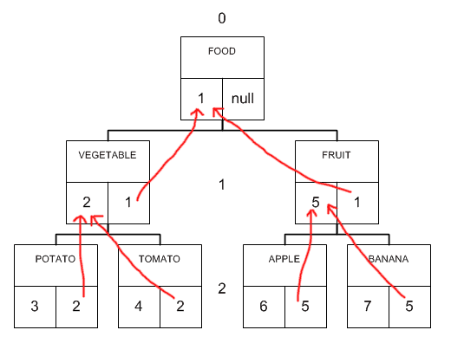

Slide 4
CREATE TABLE al_tree (
id INT NOT NULL,
parent_id INT NULL,
name VARCHAR(50) NOT NULL
);
CREATE INDEX fk_tree_tree ON al_tree (parent_id);
ALTER TABLE al_tree ADD CONSTRAINT fk_tree_tree
FOREIGN KEY (parent_id) REFERENCES al_tree (id) ON UPDATE CASCADE ON DELETE CASCADE;
INSERT INTO al_tree VALUES
(1, NULL, 'FOOD'),
(2, 1, 'VEGETABLE'),
(3, 2, 'POTATO'),
(4, 2, 'TOMATO'),
(5, 1, 'FRUIT'),
(6, 5, 'APPLE'),
(7, 5, 'BANANA');

Slide 5
+----+-----------+-----------+
| id | parent_id | name |
+----+-----------+-----------+
| 1 | NULL | FOOD |
| 2 | 1 | VEGETABLE |
| 3 | 2 | POTATO |
| 4 | 2 | TOMATO |
| 5 | 1 | FRUIT |
| 6 | 5 | APPLE |
| 7 | 5 | BANANA |
+----+-----------+-----------+

Slide 6
Вложенное множество (Nested set)

Slide 7
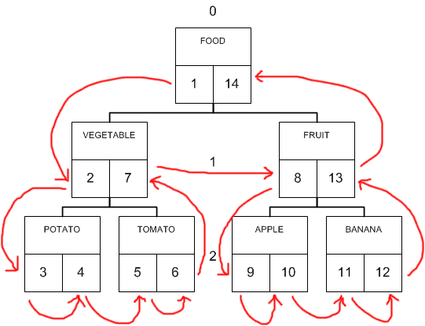

Slide 8
CREATE TABLE ns_tree (
id INT NOT NULL,
name VARCHAR(50) NOT NULL,
lft INT NOT NULL,
rgt INT NOT NULL,
level INT NOT NULL
);
CREATE INDEX nslrl_idx ON ns_tree (lft, rgt, level);
INSERT INTO ns_tree VALUES
(1, 'FOOD', 1, 14, 0),
(2, 'VEGETABLE', 2, 7, 1),
(3, 'POTATO', 3, 4, 2),
(4, 'TOMATO', 5, 6, 2),
(5, 'FRUIT', 8, 13, 1),
(6, 'APPLE', 9, 10, 2),
(7, 'BANANA', 11, 12, 2);

Slide 9
SELECT node.id, node.name, node.level
FROM ns_tree AS node,
ns_tree AS parent
WHERE node.lft BETWEEN parent.lft AND parent.rgt
AND parent.id = 1
ORDER BY node.lft;
Результат будет таким:
+----+-----------+-------+
| id | name | level |
+----+-----------+-------+
| 1 | FOOD | 0 |
| 2 | VEGETABLE | 1 |
| 3 | POTATO | 2 |
| 4 | TOMATO | 2 |
| 5 | FRUIT | 1 |
| 6 | APPLE | 2 |
| 7 | BANANA | 2 |
+----+-----------+-------+

Slide 10
Пример: вывести часть ветки, в корневом узле которого находится “Vegetable”.
SELECT node.id, node.name, node.level
FROM ns_tree AS node, ns_tree AS parent
WHERE node.lft BETWEEN parent.lft AND parent.rgt AND parent.id = 2
ORDER BY node.lft;
Результат:
+----+-----------+-------+
| id | name | level |
+----+-----------+-------+
| 2 | VEGETABLE | 1 |
| 3 | POTATO | 2 |
| 4 | TOMATO | 2 |
+----+-----------+-------+

Slide 11
Materialized Path

Slide 12
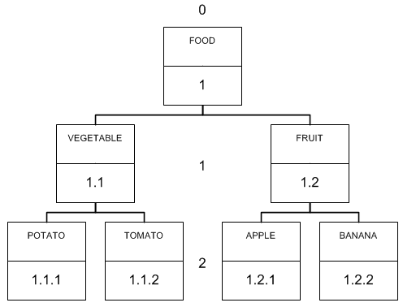

Slide 13
CREATE TABLE mp_tree (
id INT NOT NULL,
name VARCHAR(50) NOT NULL,
path VARCHAR(100) NOT NULL
);
CREATE INDEX mpp_idx ON mp_tree (`path`);
INSERT INTO mp_tree VALUES
(1, 'FOOD', '1'),
(2, 'VEGETABLE', '1.1'),
(3, 'POTATO', '1.1.1'),
(4, 'TOMATO', '1.1.2'),
(5, 'FRUIT', '1.2'),
(6, 'APPLE', '1.2.1'),
(7, 'BANANA', '1.2.2');

Slide 14
Получаем результат:
+---------------+-------+
| name | path |
+---------------+-------+
| FOOD | 1 |
| VEGETABLE | 1.1 |
| POTATO | 1.1.1 |
| TOMATO | 1.1.2 |
| FRUIT | 1.2 |
| APPLE | 1.2.1 |
| BANANA | 1.2.2 |
+---------------+-------+

Slide 15
СПАСИБО ЗА ВНИМАНИЕ

